Slide 1
Numerical examples
The stator of a 3-phase, 10-pole induction motor possesses 120 slots. If 60⁰ groups, 2-layer lap winding is used, calculate
The total number of coils
The number of coils per group
Indicate the arrangement and slot numbering of three successive groups of a phase all connected in series. The coils are multi-turn and full-pitch.

Slide 2
Solution
(a) For 2-layer winding, the number of coils = the no. of slots = 120
(b) For 60º, 2-layer winding,
m = no. of coils per group
= no. of slots per pole per phase
= 120/(10 x3) = 4
(c) Slot span = S/2p = 120/10 = 12.

Slide 3
Therefore y_{b} = slot span x u = 12 x 1 = 12 coil sides.
Thus the return conductor for top layer conductor 1 is 13', for top layer conductor 2 is 14', etc.
The top layer are grouped as follows, first 4 conductors to A, next 4 conductors to C', next 4 conductors to B, next 4 conductors to A', etc.

Slide 4
The arrangement and slot numbering of three successive coil groups of phase A:
  coil group A starts at 1 and ends at 4,
  coil group A' starts at 13 and ends at 16 and another
  coil group A starts at 25 and ends at 28
Arrangement is shown below

Slide 5
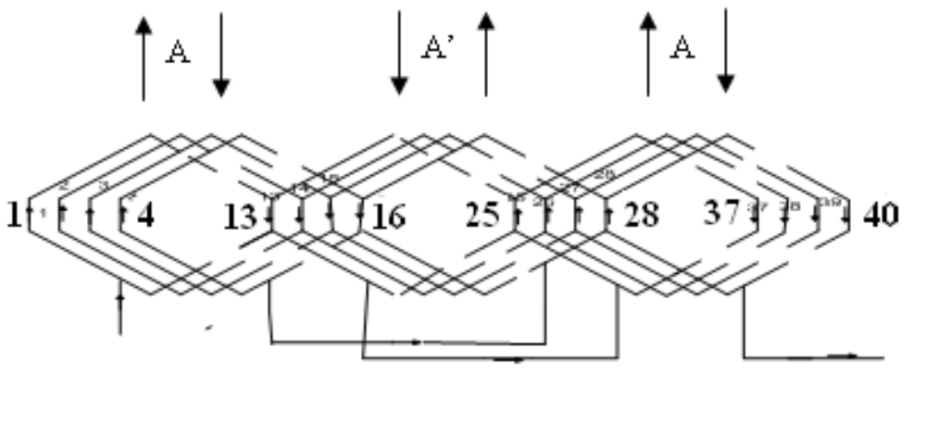
NB: The connection between coils and coils groups should be well indicated.

Slide 6
A 20-pole stator has 180 slots with single-layer full pitch coils, 6 conductors per slot, and all coils per phase connected in series. The flux per pole is 25 mWb. Compare the 50-Hz phase emfs in a 1-ph winding with 5 adjacent slots per pole wound (the others being empty), and in a 3-ph star-connected winding with all slots wound.

Slide 7
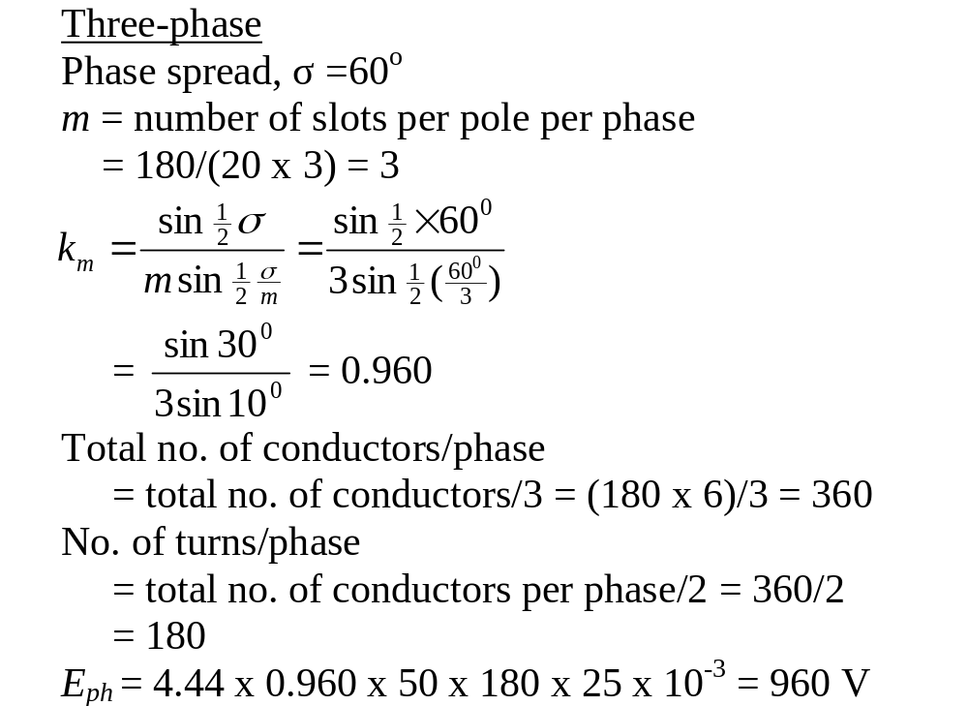

Slide 8
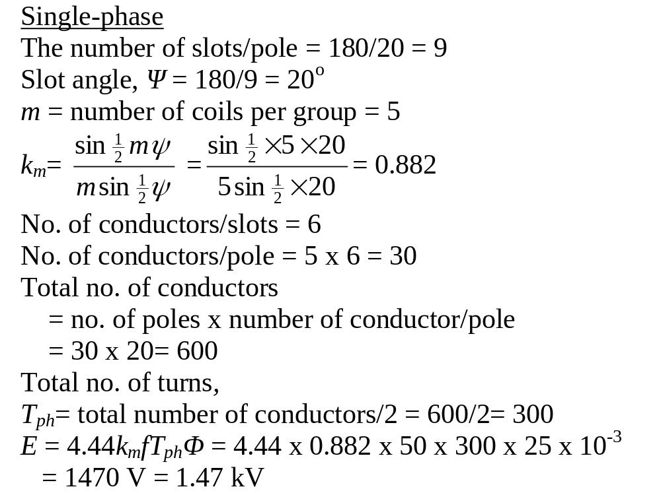

Slide 9
The field form of a 3-phase, 50 Hz, 600-rev/min alternator has spatial flux-density distribution given by B = sinθ + 0.3sin3θ + 0.2sin5θ tesla. The machine has 180 slots, wound with 2-layer 3-turn coils. Each coil spans 15 slots, the coils being connected in 60⁰ groups. The armature diameter is 125 cm and the core length is 45 cm. Calculate (a) the number of poles (b) the rms phase and line voltages.

Slide 10
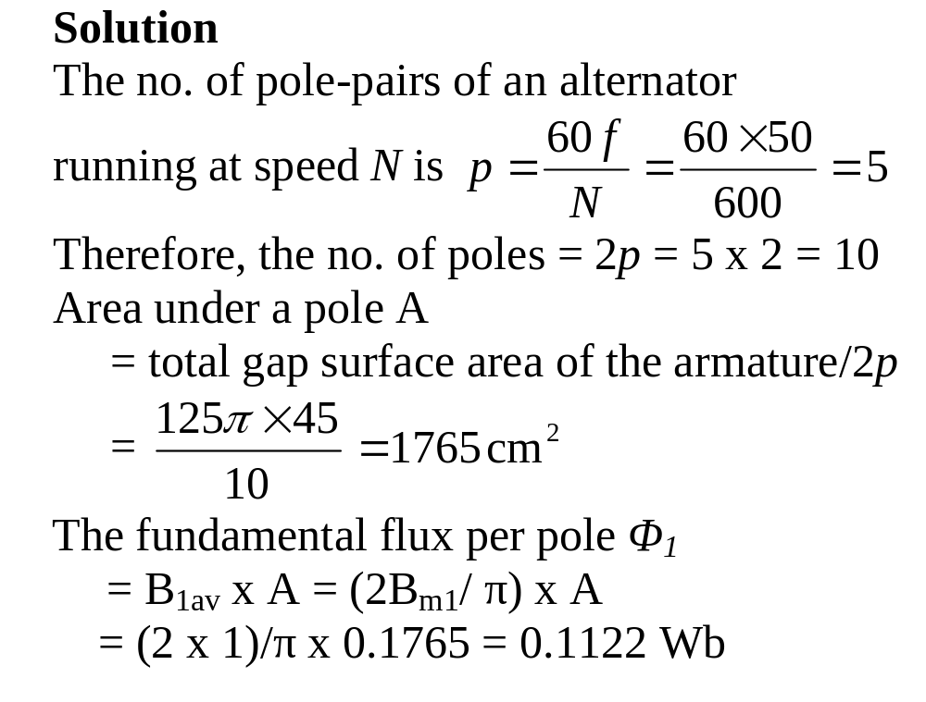

Slide 11
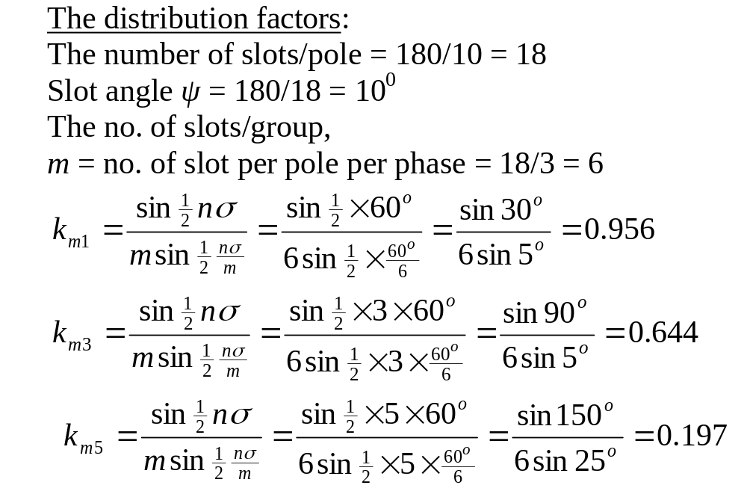

Slide 12
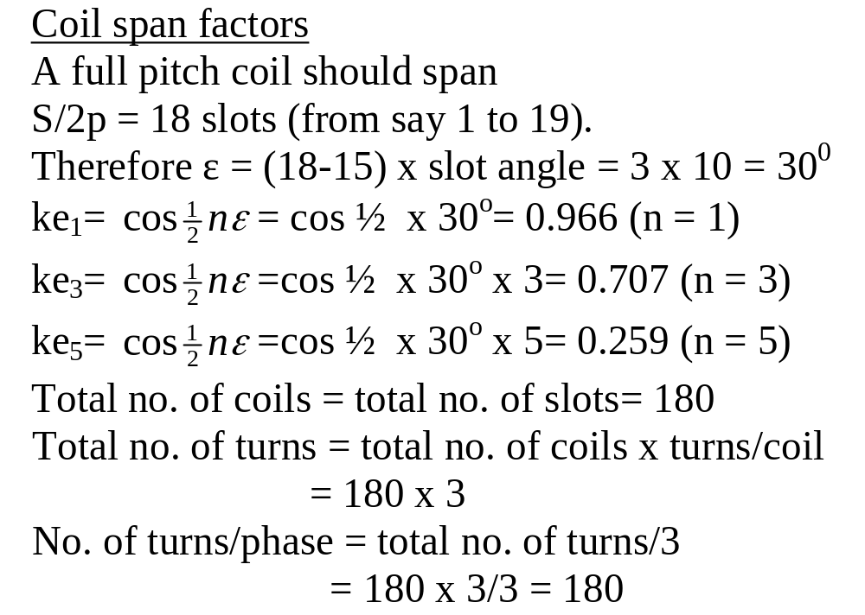

Slide 13
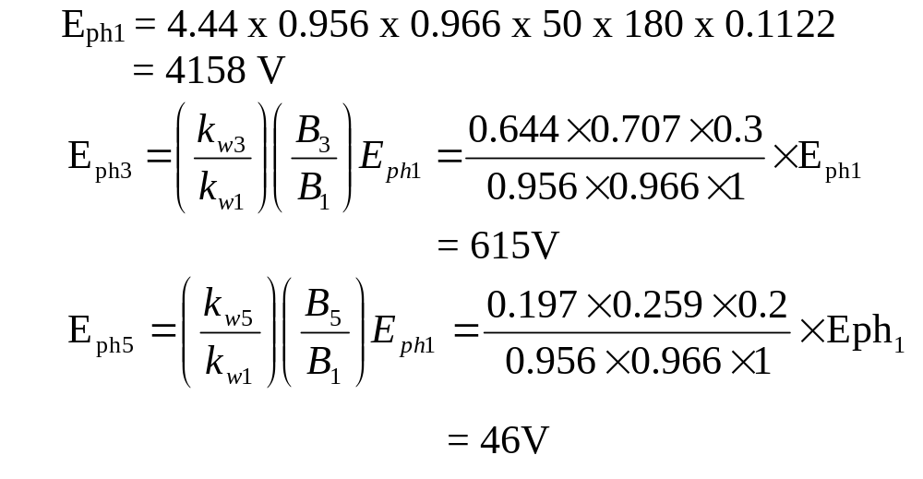

Slide 14
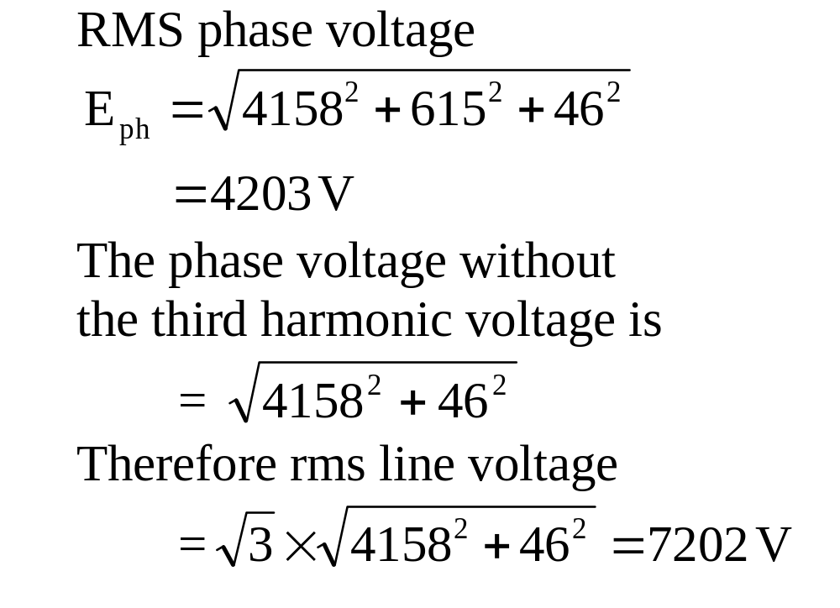

Slide 15
A stator having 24 slots has to be wound with a 3-phase, 4-pole 60⁰ group, 2-layer winding. Determine
(a) the connections between the coils
(b) the connections between the phases when
  star- connected
  delta- connected

Slide 16
Solution
For a 4-pole machine, the 24 slots is spread over 4 x 180 electrical degrees.
Therefore the total number of groups = (4 x 180)/ 60 = 12 for 60⁰ coil groups.
Number of groups/phase = 12/3 = 4.
Number of coils in a group= total number of coils /total number of groups= 24/12= 2

Slide 17
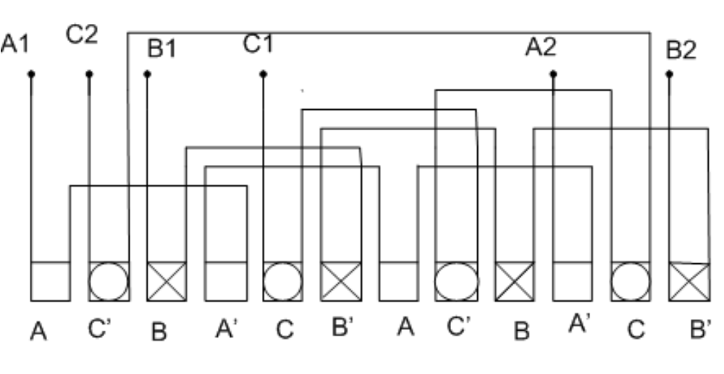

Slide 18
